Slide 1
QwickRip Documentation
David Wickizer

Slide 2
Table of contents
Summary………....................................Slide 3
Graphical User Interface (GUI).............Slide 4
GUI Explained…………………………….Slide 5
How to use QwickRip…………………….Slides 6-9
Qwickrip Folder/Files Organization…..Slides 10-11
Flow of Program…………………………..Slide 12

Slide 3
Summary
The goal of QwickRip is to extract key information from a set of narratives. This key information includes money amounts, bank names, credit/debit card numbers, bitcoin addresses, emails, websites, IP addresses, and country names. More key information can be added to this list as there is a demand for it. Not only will QwickRip rip all of these fields out of a set of narratives, it will also count how many times each item in each field appears within each BSA narrative, and it will also show how many times it pops up throughout all of the narratives (a total count of each item throughout all narratives). Users can order the output of the search results by alphabetical order, or by frequency of the term popping up throughout the narrative(s).

Slide 4
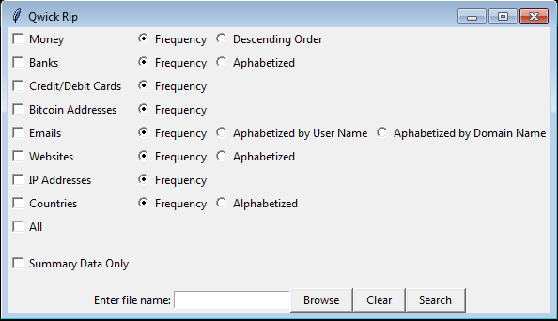
Graphical User Interface (GUI)

Slide 5
GUI Explained
On the left side of the interface is a vertical column where the user can check what fields they want to search for, throughout a set of narratives. As of right now users can search for money, banks, credit/debit cards, bitcoin addresses, emails websites, IP addresses, and/or countries.
To the right of each check box is a set of radio buttons which control how the output is to be organized (by frequency of occurrence, alphabetized, etc).
If users wish to see only the total number of hits for each field search, then they can check the “Summary Data Only” checkbox located on the bottom left of the GUI.

Slide 6
How to use QwickRip
First, you must have Python 3.5.1 installed on your computer with the openpyxl library installed as well.
Python 3.5.1 is for running the overall code, and openpyxl is for running the code that deals with handling excel files.
If you wish to make edits to the code or look at the code for any reason you must have a text editor installed (Notepad++ for example) Note: changing the code will permanently affect the program.
Next, you must have the QwickRip folder placed on your H Drive.
Next, you must place the desired .xlsx file (Excel file) to be searched, in the QwickRip folder.
The file to be searched should be saved as a .xlsx file for the program to work.
The file should be formatted so that the narratives are in one column, and the BSA IDs associated with each narrative are in the column next to it. The first cell of the narratives column should be “NRTV_TXT” and the first cell of the BSA IDs column should be “BSA_ID” (picture example on next slide) Note: this is the default output of SAS when exporting to Excel.

Slide 7
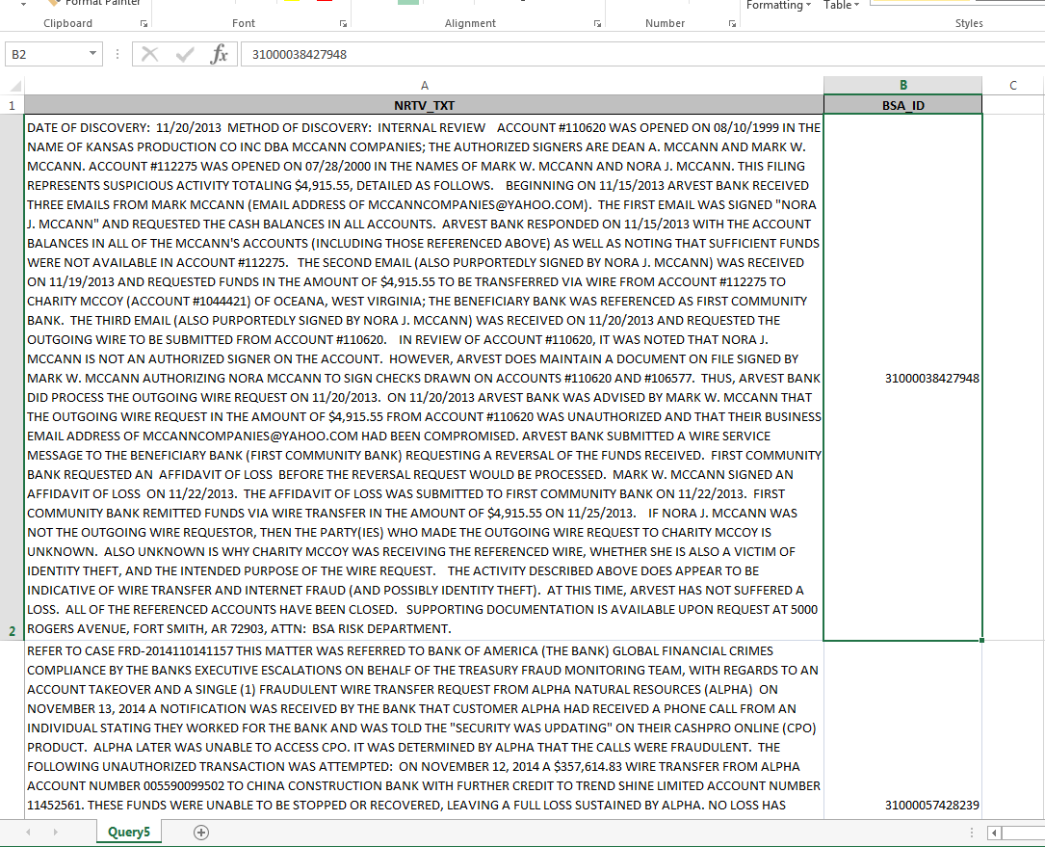

Slide 8
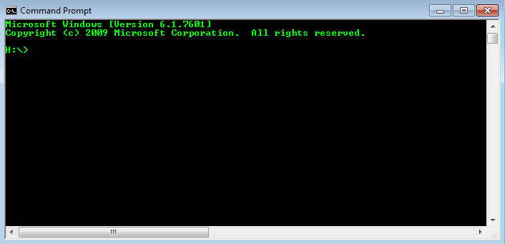
How to use QwickRip (cont.)
Once you have placed the properly formatted file into the QwickRip folder, the next step is to open up the Command Prompt to run the program.
Click the windows logo at the bottom left of the screen (Start button), and search for “Command Prompt”. Click on the application to run it.
Now that the command prompt is open it should look like this:

Slide 9
How to use QwickRip (cont.)
The Command Prompt is currently in the H drive directory. The next step is to navigate to the QwickRip directory (folder) to run the QwickRip.py file.
On the command prompt, type the command “cd QwickRip” and press enter to navigate to the QwickRip directory:
Now that you are in the QwickRip directory, type the command “python QwickRip.py” and press enter to run the program:
At this point the graphical user interface (GUI) should pop up and you can enter the file name that you want to search, and specify what fields you want to search for within the file. (Remember: file should already be placed in the QwickRip folder and should be saved as a .xlsx file).
To exit the program click the on the upper right of the GUI.
To rerun the program, simply retype the “python QwickRip.py” command and press enter (or press the up arrow key to bring up the previous command and press enter).
The output will be written to RippedData.txt which will be located in the QwickRip folder. It can be viewed with a text editor (Notepad++).

Slide 10
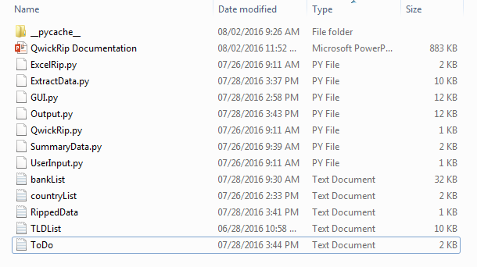
Qwickrip folder/files organization

Slide 11
Qwickrip folder/files organization
__pycache__: Folder of compiled files after program is ran at least once
QwickRip Documentation: This PowerPoint
ExcelRip.py: Reads the Narratives and BSA IDs from the excel file, and stores them to memory for later use
ExtractData.py: Pulls out the key information from the narratives and stores it for later output
GUI.py: Initializes the Graphical User Interface and handles button clicks on the GUI
Output.py: Responsible for handling the output of the program after it is done pulling out key information. Writes to RippedData.txt
QwickRip.py: Entry point of program
SummaryData.py: Summarizes the data that was extracted from ExtractData.py and stores it for later output
UserInput.py: Handles the input (file name) that the user enters in text field on the GUI
bankList: Text file containing a list of bank names
countryList: Text file containing a list of country names
TLDList: Text file containing a list of Top Level Domains
RippedData: Output file
ToDo: To-do list of items that need to be taken care of within the program

Slide 12
FLOW OF PROGRAM
Initialize GUI
User input file name
File is good
QwickRip
GUI
UserInput
Narratives are paired with BSA IDs in memory
Key info is extracted from the narratives
Extracted info is summarized
ExcelRip
ExtractData
SummaryData
Output
1. Extracted data is output in relation to each SAR it shows up in.
2. Summary Data is output

Slide 13
Known Bugs
Banks, websites, and countries searches are slow
Bitcoin Addresses aren't all bitcoin addresses
Index out of bounds error in ExtractData.ripWords() when dealing with large data
Clean up money dictionary. If input comes in as $3,000,457.23dsfsfd...strip it to be $3000457.23. Right now if money comes in with values other than "$", digits, or "." it will screw up the program because its trying to convert that to a float in Output.descendingKey
() {} [] <> "" '‘ are not being removed on some words
If just an @ or $ is found remove it from dictionaries
Money values have random strings attached to the end of the number (_x000D_)
When alphabetizing emails by domain name...it works but emails that are all caps are treated seperately from noncap emails

Slide 14
Features to Add
Toggle feature to turn off frequency values in summary data output
Sort money dictionary by key in descending order. (Output.descendingKey())
Alphabetize emails by domain name4. Add the ability to browse for file with browse button
Loading bar while program is processing
Desktop icon
Ability to search a name and show all of the sars related to it
Ability to search for a specific word and tally it up
Better User Interface

